Slide 1

Università degli Studi di Salerno
Dipartimento di Informatica
a.a. 2019/2020
Gender Classification using a Spider Web Method
Relatori:
Dott. ssa Carmen Bisogni
Dott. ssa Paola Barra
Studente:
Russo Vincenzo
Matr: 0522500860

Slide 2

Outline
Motivations and goals
Models Used
Experiments and Results
Conclusions

Slide 3

Motivations and goals

Slide 4
Motivations and goals
In Today world is very important to be able to predict a person’s gender
It’s possible to use makeup for deceive an identification system
Also privacy issues because storing the color image of a person is considered sensible data
Our goal is to find an accurate gender prediction system which doesn’t involve storing personal data as a template i.e. face images

Slide 5
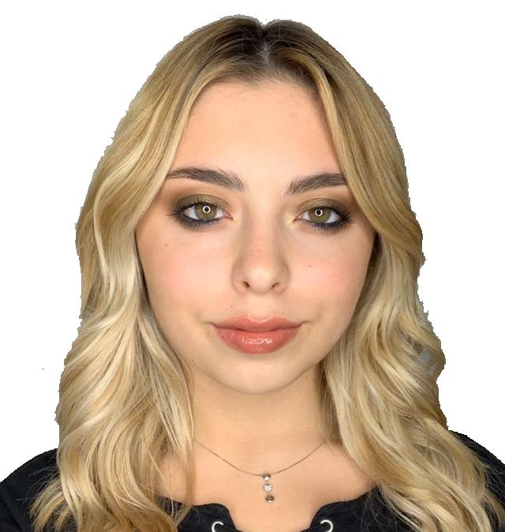
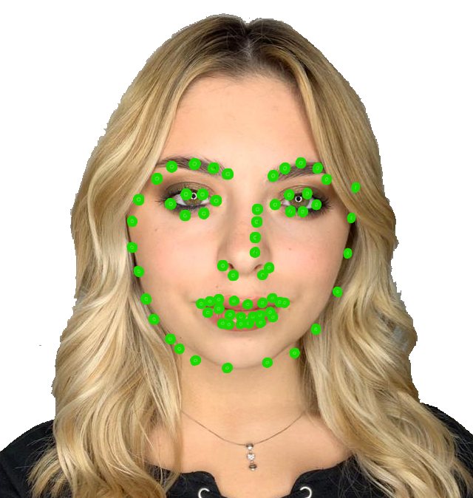
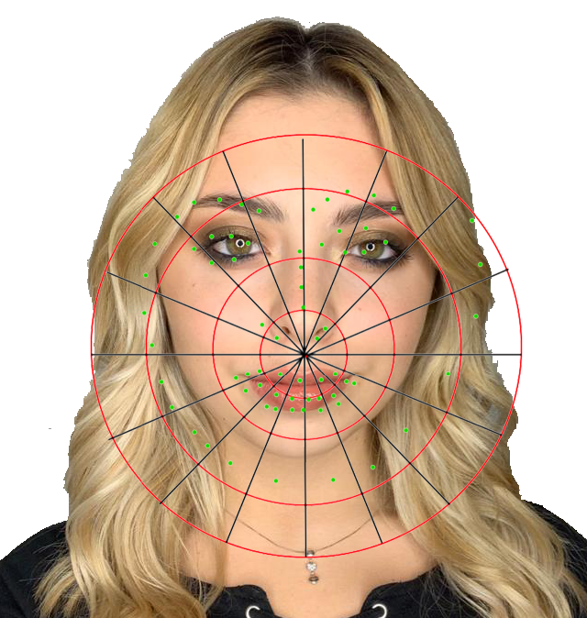

Gender Classification

Slide 6


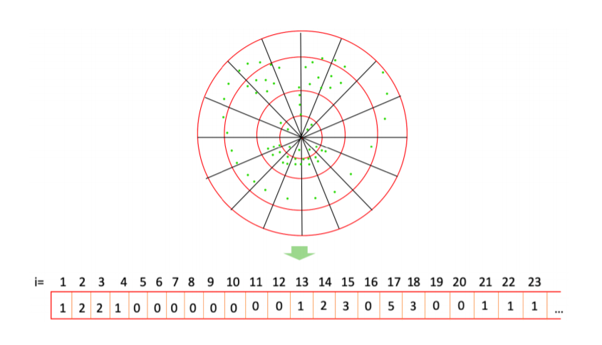
Gender Classification

Slide 7

Models Used

Slide 8
Web-Shaped Model
To build a pose feature vector each landmark needs to be associated with a specific sector of the model
This process is carried out by first detecting the circle, the quarter and then the slice to which a specific landmark belongs to
For this study we used 4 circles 4 sectors. Giving as output a 64 dimensions vector
The algorithm was given by the tutors

Slide 9
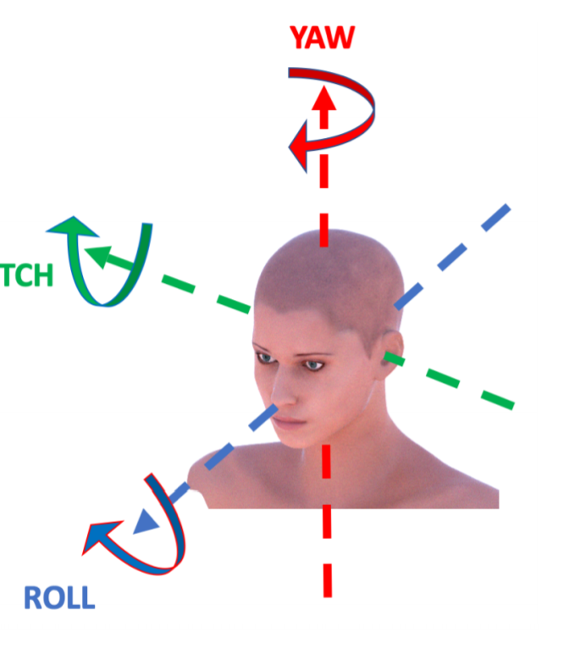
Web Shaped Model
The purpose of the algorithm given us is pose estimation, it was used for:
Face detection
Extraction of the landmarks
Assigning each landmark to the sector on the web

Slide 10
Web Shaped Model

Slide 11
Support Vector Machine
Despite the high training cost we decided to use Linear SVM because of:
Model simplicity
Good classification generalization for binary problems
Training efficiency
Being less prone to overfitting new data

Slide 12
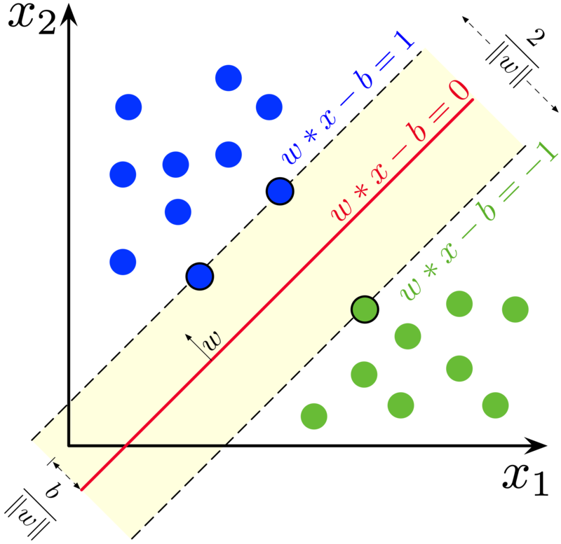

Slide 13

Experiments and Results

Slide 14
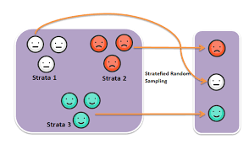
Stratified Sampling
Stratification is the process of dividing members of the population into homogeneous subgroups before sampling.

Slide 15
Surplus of individuals by a given gender
 | Surplus | Gender
CelebA | 30672 | F
UTKFace | 901 | M
Combined | 30878 | F

Slide 16
UTKFace Surplus

Slide 17
CelebA Surplus

Slide 18
Training times for the linear SVM
BALANCED
UNBALANCED
 | Time (hours)
CelebA | 4,5
UTKFace | 0,15
Combined | 6
 | Time (hours)
CelebA | 6,5
UTKFace | 0,45
Combined | 8

Slide 19
Input size vs Training time (hours)

Slide 20
MAE Score
BALANCED
UNBALANCED
 | MAE
CelebA | 0,29
UTKFace | 0,31
Combined | 0,30
 | MAE
CelebA | 0,28
UTKFace | 0,33
Combined | 0,30

Slide 21
MAE Scores

Slide 22

Conclusions

Slide 23
Conclusions
The stratification of the datasets helped the SVM to converge earlier
As further developments we could:
Normalize the vector data in the range [0,1]
Choose a better classifier for binary classification task using sparse low dimensional vectors
item Tweak the linear SVM hyperparameters
Using a non-linear kernel for the SVM

Slide 24
Thanks for the attention

